Slide 1


CRICKSTER
MENTOR
Mr. AYUSH SAXENA
MEMBERS:-
VARUN RAO (19ET2005)
AMOG RAI (19ET2016)
SIDDESH LABADE (19ET1018)
ARPIT SAINI (19ET2007)

Slide 2
ABSTRACT
Cricket, especially the Twenty20 format, has maximum uncertainty, where a single over can completely change the momentum of the game. With millions of people following Cricket, developing a model for predicting the outcome of its matches is a real-world problem. A cricket match depends upon various factors, and in this work, the factors which significantly influence the outcome of a Twenty20 cricket match are identified. Each players performance in the field is considered to find out the overall weight (relative strength) of the team. A multivariate regression based solution is proposed to calculate points of each player in the league and the overall weight of a team is computed based on the past performance of the players who have appeared most for the team.
In this paper, the past seven years data of cricket containing the players details, match venue details, teams, ball to ball details, is taken and analyzed to draw various conclusions which help in the improvement of a players performance. Various other features like how the venue or toss decision has influenced the winning of the match in last seven years are also predicted. Machine learning and data extraction models are considered for prediction is random Forest Regressor. Machine learning models were trained and used for predicting the outcome of each 2018 match. We performed three types of prediction toss-winner prediction, 2 inning score prediction and the actual winner prediction. The prediction results are impressive.

Slide 3
LITERATURE SURVEY
We discuss the analysis role of machine learning in the improvement of performances of players and the team in different sports and how it helps the players to know their performance levels and further improvements. We aim to make a model which initially collects raw data and these data are stored and clustered since the data is very large .
Problem Statement
In this to design a system that can be provide the score and winning prediction in cricket match, the system can analyze multiple parameters like , batting average , bowling average, player wise performance etc. while declaring a time for particular championship it is very important to select the best team so that the chances of the team winning the championship become easy.
Solution
This problem had to be solved to generate the best players for a team for the best result. To solve this Problem we have collected historical data of some players, and using prediction algorithm like Random Forest algorithm we are predicting the best players for the team that can be used in International Tournaments for winning the maximum matches.

Slide 4
SOFTWARE USED
EXCEL
Python 3.6.3
VS Code

Slide 5
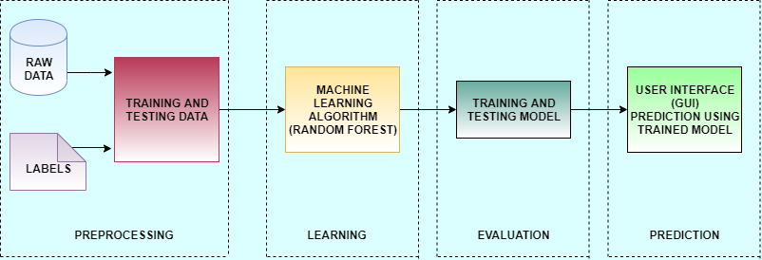
WORK FLOW

Slide 6
The methodology consists of 3 main stages- Data Preprocessing, Data Preparation, Encoding the data. Initially, the seven IPL seasons real-time dataset is taken in CSV format. In data preprocessing phase, the data is incomplete, noisy and inconsistent. The data preparation is significant for achieving optimal results. This involves choosing an outcome measure to evaluate different predictor variables. In data Encoding phase, label each term with short names and encode them as numerical values for predictive modeling.
Random Forest
Random forest is a Supervised Learning algorithm which uses ensemble learning method for classification and regression.
Random forest is a bagging technique and not a boosting technique. The trees in random forests are run in parallel. There is no interaction between these trees while building the trees.
It operates by constructing a multitude of decision trees at training time and outputting the class that is the mode of the classes (classification) or mean prediction (regression) of the individual trees.
A random forest is a meta-estimator (i.e. it combines the result of multiple predictions) which aggregates many decision trees, with some helpful modifications:
The number of features that can be split on at each node is limited to some percentage of the total (which is known as the hyper parameter).
This ensures that the ensemble model does not rely too heavily on any individual feature, and makes fair use of all potentially predictive features.
Each tree draws a random sample from the original data set when generating its splits, adding a further element of randomness that prevents overfitting.

Slide 7
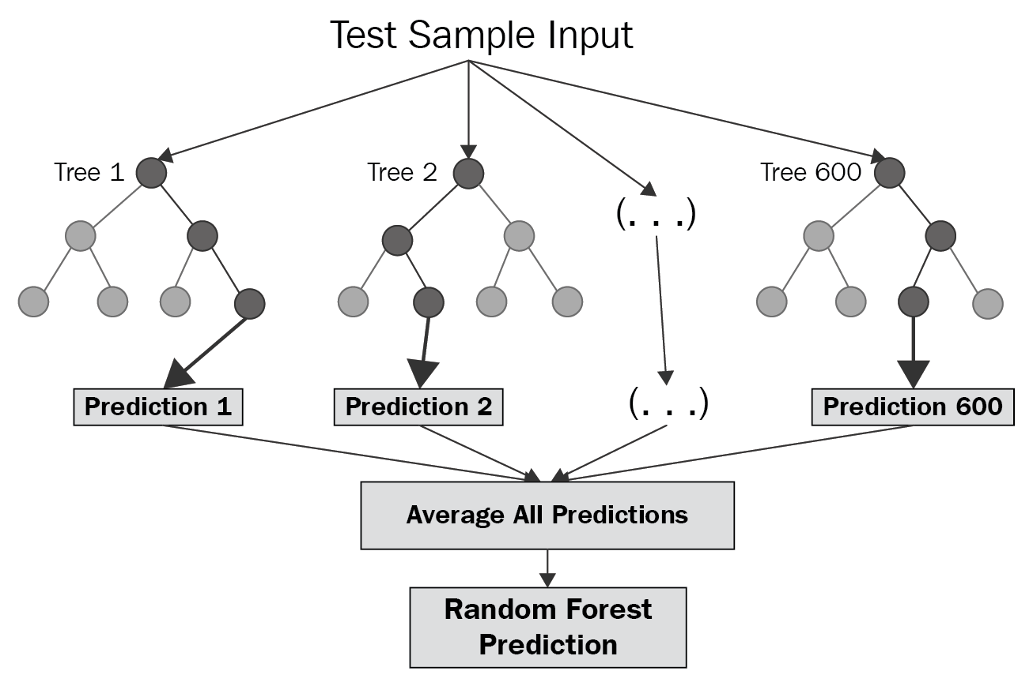
2.System Development Life Cycle:
The System Development Life Cycle is the process of developing information systems through investigation, analysis, design, implementation, and maintenance.
The System Development Life Cycle (SDLC) is also known as Information Systems Development or Application Development.

Slide 8
➔ Steps involved in the System Development Life Cycle:
Below are the steps involved in the System Development Life Cycle. Each phase within the overall cycle may be made up of several steps.
Step 1:Software Concept
The first step is to identify a need for the new system. This will include determining whether a business problem or opportunity exists, conducting a feasibility study to determine if the proposed solution is cost effective, and developing a project plan.
This process may involve end users who come up with an idea for improving their work. Ideally, the process occurs in tandem with a review of the organization's strategic plan to ensure that IT is being used to help the organization achieve its strategic objectives. Management may need to approve concept ideas before any money is budgeted for its development.
Step 2:Requirements Analysis
Requirements analysis is the process of analyzing the information needs of the end users, the organizational environment, and any system presently being used, developing the functional requirements of a system that can meet the needs of the users. Also, the requirements should be recorded in a document, email, user interface storyboard, executable prototype, or some other form. The requirements documentation should be referred to throughout the rest of the system development process to ensure the developing project aligns with user needs and requirements.
Professionals must involve end users in this process to ensure that the new system will function adequately and meets their needs and expectations.
Step 3:Architectural Design
After the requirements have been determined, the necessary specifications for the hardware, software, people, and data resources, and the information products that will satisfy the functional requirements of the proposed system
can be determined. The design will serve as a blueprint for the system and helps detect problems before these errors or problems are built into the final system. Professionals create the system design, but must review their work with the users to ensure the design meets users' needs.

Slide 9
Step 4:Coding and Debugging
Coding and debugging is the act of creating the final system. This step is done by software developer.
Step 5:System Testing
The system must be tested to evaluate its actual functionality in relation to expected or intended functionality. Some other issues to consider during this stage would be converting old data into the new system and training employees to use the new system. End users will be key in determining whether the developed system meets the intended requirements, and the extent to which the system is actually used.
Step 6:Maintenance
Inevitably the system will need maintenance. Software will definitely undergo change once it is delivered to the customer. There are many reasons for the change. Change could happen because of some unexpected input values into the system. In addition, the changes in the system could directly affect the software operations. The software should be developed to accommodate changes that couldhappen during the post implementation period.
There are various software process models like:-
Prototyping Model
RAD Model
The Spiral Model
The Waterfall Model
The Iterative Model
Of all these process models we’ve used the Iterative model(The Linear Sequential Model) for the development of our project.

Slide 10
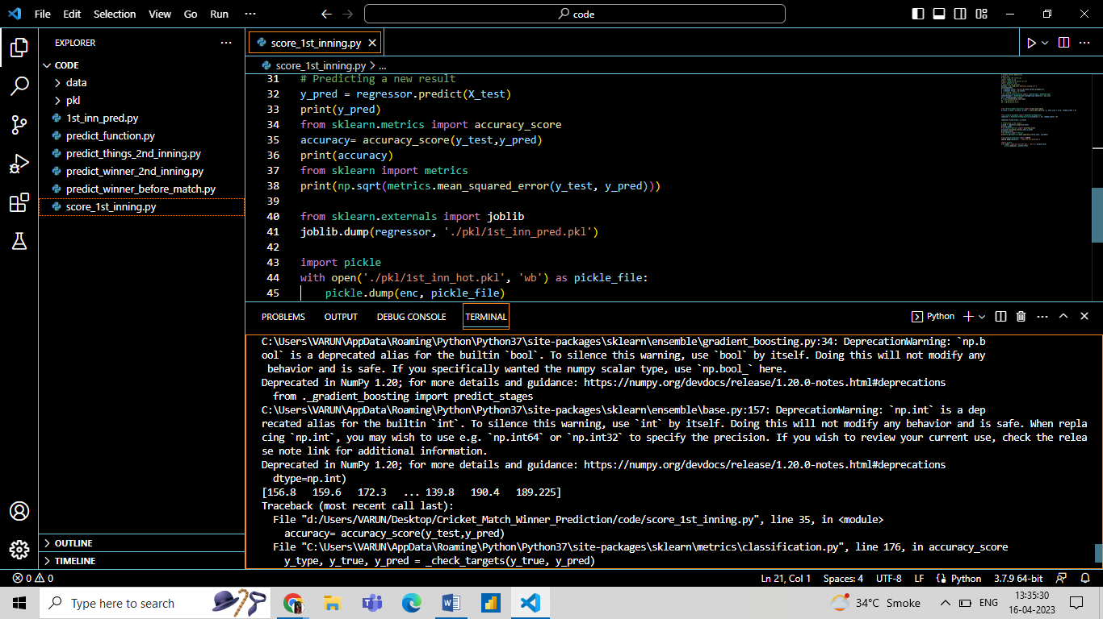
RESULTS

Slide 11
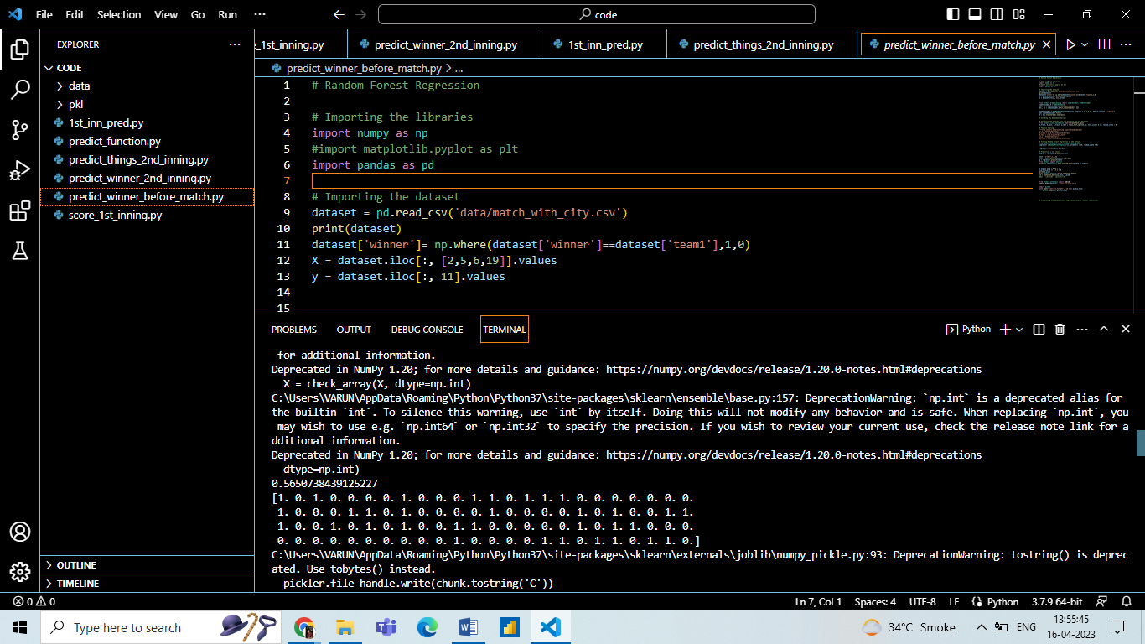

Slide 12
CONCLUSION
Selection of the best team for a cricket match plays a significant role for the team’s victory. The main goal of this paper is to analyze the cricket data and predict the players’ performance. Here, three classification algorithms are used and compared to find the best accurate algorithm. Random Forest is observed to be the best accurate classifier with 89.15% to predict the best player performance. This knowledge will be used in future to predict the best team.

Slide 13
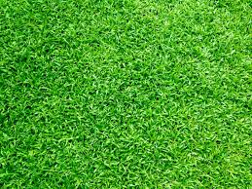
THANK YOU

